Slide 1
RTD Measurement Step-by-step Design Procedure
October 2014
Joachim Wurker
Systems & Applications Manager
Precision Delta-Sigma ADCs

Slide 2
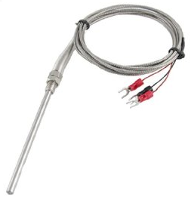
RTD Resistance Temperature Detector
Principle of Operation: Predictable resistance change
Mostly made of Platinum
linear resistance-temperature relationship
chemical inertness
Pt100 most common device used in industry
Nominal Resistance R = 100Ω @ 0°C
Sensitivity = 0.385Ω/°C (typ.)
Slowly replacing thermocouples in many industrial applications below 600°C due to higher accuracy, stability and repeatability
2-, 3-, 4-wire types
Advantages
Disadvantages
High accuracy: < ±1°C
Best stability over time
Temperature range: -200°C to +850°C
Good linearity
Expensive
Excitation required
Self-heating
Lead resistance
Low sensitivity
Notes:
RTDs offer good linearity, temperature range, long-term stability, repeatability. The RTD is the measurement device used in establishing the International Temperature Scale of 1990 (ITS-90) between 14 and 962K.
Over the full temperature range, the RTD resistance varies in a non-linear fashion from 35Ω – 370Ω
RTD downsides are their cost (wire-wound are much more expensive than thin-film), the requirement for an excitation source, and fine resolution. A 1°C change in temperature correlates to a 0.385Ω change in resistance, demanding accurate acquisition circuitry.
Measuring resistance allows for a back-calculation of the temperature.
Inject a current, measure the voltage, R= V/I
Temperature can then be calculated either directly, estimated using linear interpolations, or rounded to the closest look-up table value.

Slide 3
What is an RTD made of?
Metal | Resistivity (Ohm/CMF)
Gold (Au) | 13
Silver (Ag) | 8.8
Copper (Cu) | 9.26
Platinum (Pt) | 59
Tungsten (W) | 30
Nickel (Ni) | 36
Platinum (Pt)
Nickel (Ni)
Copper (Cu)
Have relatively linear change in resistance over temp
Have high resistivity allowing for smaller dimensions
Either Wire-Wound or Thin-Film
^{(*)}Images from RDF Corp
Notes:
RTDs are commonly made of Pt, Ni, and Cu. This is mainly because over certain temperature ranges they experience fairly linear changes in resistance vs. temperature. Also, their properties allow for convenient resistance values to be created out of convenient sized sensors.
Platinum is most commonly used because it has a very high resistivity compared to the other common metals allowing for the creation of small thin-film elements.
Ohm/CMF = Ohms per “Circular Mil Foot”

Slide 4
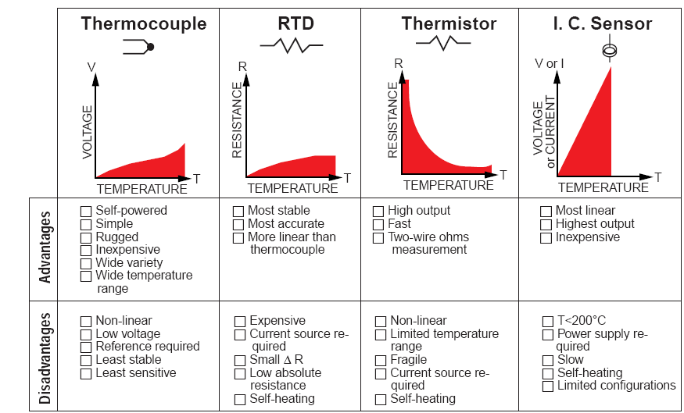
Why use an RTD?
Notes:
RTDs offer good linearity, temperature range, long-term stability, repeatability. The RTD is the measurement device used in establishing the International Temperature Scale of 1990 (ITS-90) between 14 and 962K.
RTD downsides are their cost (wire-wound are much more expensive than thin-film), the requirement for an excitation source, and fine resolution. A 1C change in temperature correlates to a 0.385 change in resistance, demanding accurate acquisition circuitry.

Slide 5
RTD Resistance vs. Temperature
Callendar-Van Dusen Equations
IEC60751 Constants:
R₀ = 100Ω
A = 3.9083 ∙10⁻³
B = -5.775 ∙10⁻⁷
C = -4.183 ∙10⁻¹²
Pt100:
α = 0.385 @ 0°C
R₀ = 100Ω @ 0°C
Notes:
Now that we’ve successfully measured the RTD resistance we need to determine the temperature based on the resistance. The Callendar Van-Dusen equation defines the resistance vs. temperature characteristics of a platinum RTD. This is a non-linear model that is a fourth order polynomial for T < 0ºC and quadratic for T > 0ºC. Primary RTD standards have been created that specify the RTD resistance at 0C, the temperature coefficient, Alpha (α ), and the Callendar Van-Dusen constants.

Slide 6
Different RTD Types – why do they exist? (I)
2-Wire RTD
2-Wire measurements are simplest to implement
Good for close proximity to RTD (R_{L} is small)
RTD lead resistance is included in the result
Tradeoff:
Accuracy: Error = 2∙R_{L}∙I_{EXC}
Cost = Cheapest!
3-Wire RTD
Allows for R_{L} cancellation and remote RTD placement
Tradeoff:
Accuracy = Better
Cost = More expensive

Slide 7
Different RTD Types – why do they exist? (II)
4-Wire RTD
Kelvin Connection: Isolates the excitation path from the sensing path
2 wires carry the excitation current,
2 wires connect to high-impedance measurement circuitry
Useful when R_{L} matching becomes difficult to implement
Tradeoff:
Accuracy = Most accurate
Cost = Most expensive
Notes:
With a 4-wire RTD all lead resistance errors are removed from the measurement circuit by providing a Kelvin connection to the RTD. Two wires carry the current and the other two wires connect to the high impedance measurement circuitry. In this method the measurement circuitry does not include any lead resistance.

Slide 8
rtd excitation Methods
Voltage, Non-ratiometric
Voltage, Ratiometric
Current, Ratiometric

Slide 9
RTD Excitation Methods (I) Voltage, Non-ratiometric

Slide 10
RTD Excitation Methods (I) Voltage, Non-ratiometric
Step 1: Measure V₃ to determine excitation current (I_{EXC} = V₃/R_{REF})
Step 2: Measure V₂ to determine lead resistance
Step 3: Measure V₁ to determine RTD resistance
Notes:
V1 = VRTD + RLEAD (ain0 – ain1)
V2 = RLEAD (ain1-ain2)
V3 = VRREF (ain2 – ain3)
**change “steps” on all slides and add labels to images**

Slide 11
RTD Excitation Methods (I) Voltage, Non-ratiometric
Step 1: Measure V₃ to determine excitation current (I_{EXC} = V₃/R_{REF})
Step 2: Measure V₂ to determine lead resistance (R_{Lead} = V₂/I_{EXC})
Step 3: Measure V₁ to determine RTD resistance
Notes:
No current flows through R_{LEAD2} (high-impedance PGA)

Slide 12
RTD Excitation Methods (I) Voltage, Non-ratiometric
Step 1: Measure V₃ to determine excitation current (I_{EXC} = V₃/R_{REF})
Step 2: Measure V₂ to determine lead resistance (R_{Lead} = V₂/I_{EXC})
Step 3: Measure V₁ to determine RTD resistance (R_{RTD} = V₁/I_{EXC} - R_{Lead})

Slide 13
RTD Excitation Methods (II) Voltage, Ratiometric
Notes:
V1 = VRTD + RLEAD (ain0 – ain1)
V2 = RLEAD (ain1-ain2)

Slide 14
RTD Excitation Methods (II) Voltage, Ratiometric
Step 1: Measure V₂ to determine lead resistance
Step 2: Measure V₁ to determine RTD resistance

Slide 15
RTD Excitation Methods (II) Voltage, Ratiometric
Step 1: Measure V₂ to determine lead resistance
Step 2: Measure V₁ to determine RTD resistance

Slide 16
RTD Excitation Methods (II) Voltage, Ratiometric
Step 1: Measure V₂ to determine lead resistance
Step 2: Measure V₁ to determine RTD resistance
Code ~ R_{RTD}/R_{REF}

Slide 17
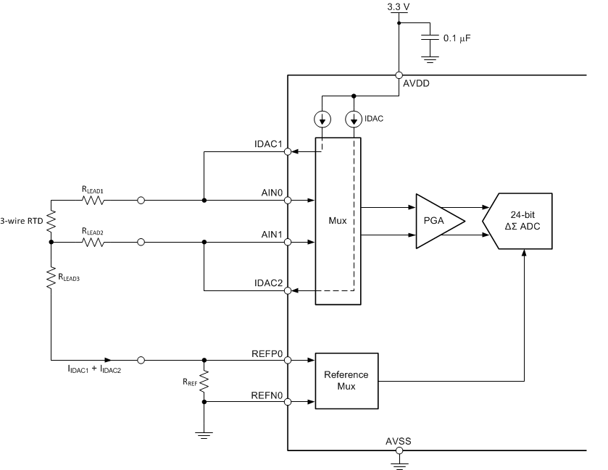
RTD Excitation Methods (III) Current, Ratiometric

Slide 18
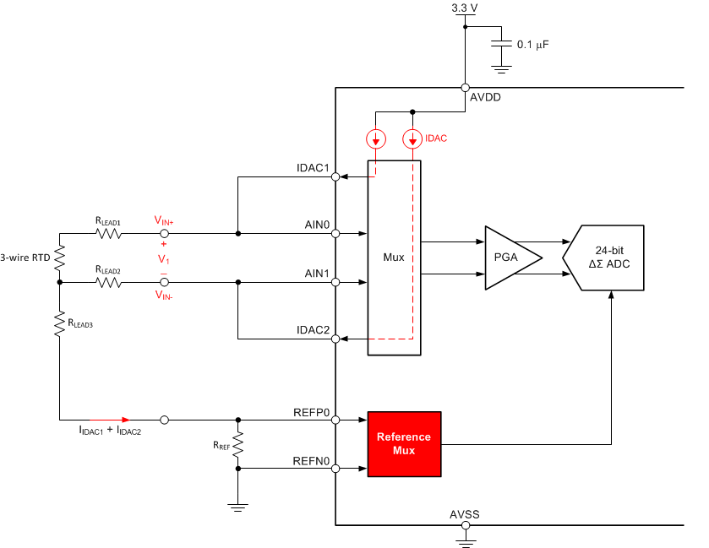
RTD Excitation Methods (III) Current, Ratiometric
Step 1: Measure V₁ to determine RTD resistance
Code ~ R_{RTD}/R_{REF}
Notes:
With a 3-wire RTD an additional wire is connected to one end of the RTD element allowing for the cancellation of the lead resistances by placing one lead resistance in series with both the positive and negative measurement connections. When the differential measurement is made, the two lead resistances cancel in the subtraction.
Using current sources as the excitation source, the lead resistances can completely cancel as long as the two current sources are matched and the lead resistances are equal.

Slide 19
RTD Excitation Methods (III) Current, Ratiometric
Step 1: Measure V₁ to determine RTD resistance
Code ~ R_{RTD}/R_{REF}
Notes:
With a 3-wire RTD an additional wire is connected to one end of the RTD element allowing for the cancellation of the lead resistances by placing one lead resistance in series with both the positive and negative measurement connections. When the differential measurement is made, the two lead resistances cancel in the subtraction.
Using current sources as the excitation source, the lead resistances can completely cancel as long as the two current sources are matched and the lead resistances are equal.

Slide 20
RTD Excitation Methods (III) Current, Ratiometric
Step 1: Measure V₁ to determine RTD resistance
Code ~ R_{RTD}/R_{REF}
R_{LEAD} Cancellation:
Notes:
With a 3-wire RTD an additional wire is connected to one end of the RTD element allowing for the cancellation of the lead resistances by placing one lead resistance in series with both the positive and negative measurement connections. When the differential measurement is made, the two lead resistances cancel in the subtraction.
Using current sources as the excitation source, the lead resistances can completely cancel as long as the two current sources are matched and the lead resistances are equal.

Slide 21
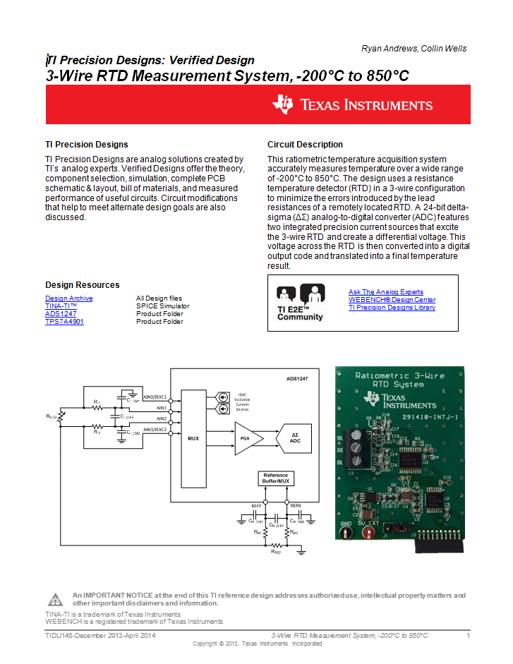
ADS1247 example
3-wire RTD Measurement
Step-by-Step Design Procedure
TIPD120

Slide 22
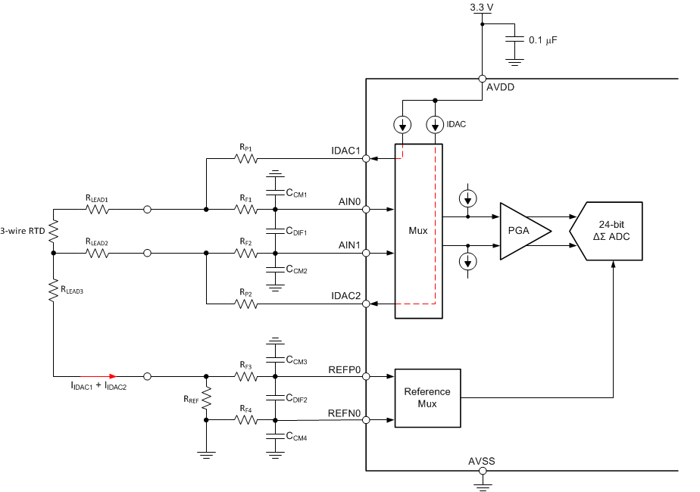
Step-by-Step Example with ADS1247
System Requirements:
RTD Type: 3-Wire Pt100
Temperature Range: -200°C to 850°C
Supply Voltage: AVDD = 3.3V
50/60Hz Rejection
Design Considerations:
Data Rate
IDAC magnitude
R_{REF}
Gain
Low-pass Filters

Slide 23
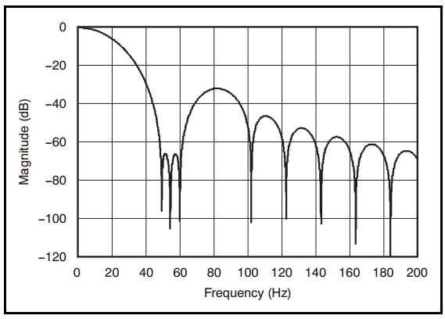
Selecting Data Rate
At Data Rate = 20SPS or less, the ADS1247 offers simultaneous 50/60Hz rejection

Slide 24
Selecting IDAC Value
Larger values produce larger signals – better resolution! (good, right?)
Causes for concern with large IDAC values:
Self-heating of RTD
IDAC compliance voltage
Start with 250μA – 1mA
Notes:
The magnitude of the current sources directly affects the magnitude of the RTD voltage. While maximizing the magnitude of the excitation current would seem desirable, higher excitation currents create a concern for violating the compliance voltage of the current source as well as errors due to self-heating.
The effects of self-heating on measurement accuracy are also based on the placement of the RTD in the application (open-air = insulates vs. moving fluid = dissipates)

Slide 25
Selecting R_{REF}
Select R_{REF} such that V_{REF} is ~40% to 50% of AVDD:
R_{REF} should be chosen with tight tolerance and low temperature drift
DC errors in R_{REF} directly affect the uncalibrated measurement gain error
Typical drift for R_{REF} = 5 – 20ppm/°C
Calculation:
Notes:
The value of R_{REF} is selected based on the IDAC setting and the desired V_{REF} voltage of 1.64 V
V_{REF} serves three purposes in a ratiometric design: it sets the input common-mode voltage (V_{CM}), the differential ADC input range (typically ±V_{REF}), and it is also used to convert the input voltage into digital output codes.

Slide 26
Selecting Gain
The largest gain will yield the best resolution per °C
Choose gain such that ADC input signal is still less than V_{REF} at the max temperature
Calculation:

Slide 27
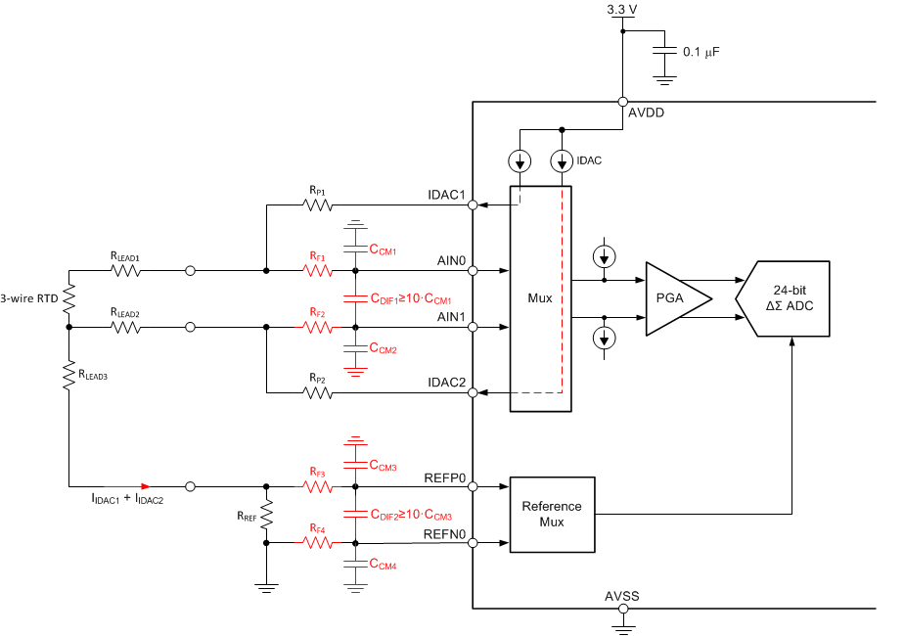
Input and Reference Filters (I)

Slide 28
Input and Reference Filters (II)
Used to filter high-frequency noise from aliasing into ADC passband
At 20 SPS, ADS1247 has -3 dB bandwidth of 14.8 Hz.
f_{-3dB_Dif} ≈ 10 x f_{-3dB_DR}
RTD input and reference filters should have matching cutoff frequencies
If noise appears on the RTD input, but not the reference, it will not be cancelled in the ratiometric configuration
The RTD will change resistance over temperature; use the mid-point of the temperature range to calculate input filter
App Note: http://www.ti.com/lit/pdf/sbaa201

Slide 29
Design checks
IDAC Compliance
Input Common-Mode Voltage

Slide 30
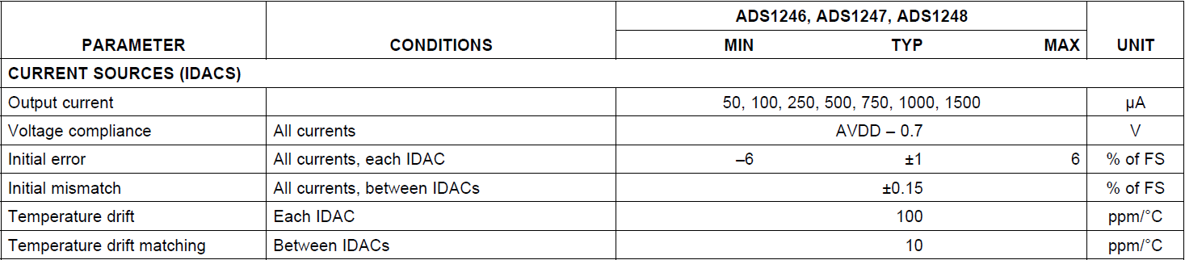
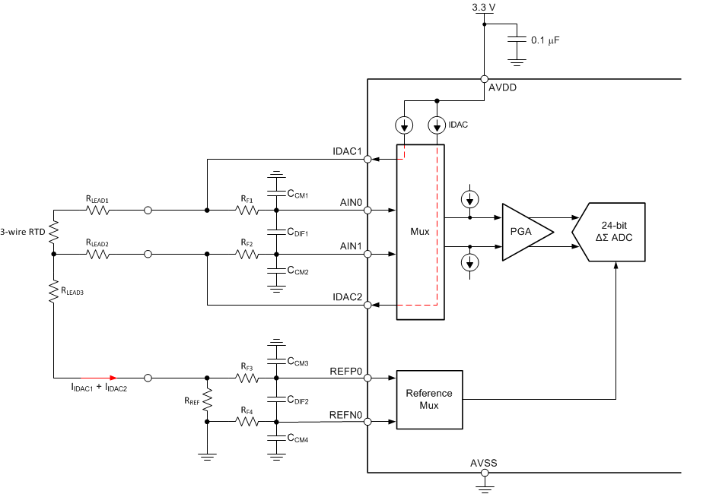
Check IDAC Compliance
☑
Notes:
Change figure to say “AIN0 – AIN3” … make consistent w/ rest
Replace w/

Slide 31
Check IDAC Compliance
☒
Notes:
Change figure to say “AIN0 – AIN3” … make consistent w/ rest
Replace w/

Slide 32
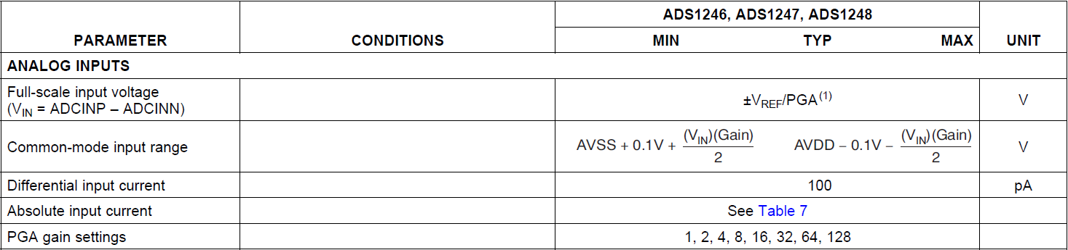
Check Input Common-Mode
☑

Slide 33
ADS1247 - Things to be Aware of
Place bypass cap on VREFOUT pin.
Turn internal V_{REF} ON, otherwise IDACs will not work.
Check IDAC compliance is met.
Check PGA common-mode voltage range is met. Single-ended measurements are NOT possible using a unipolar supply!
Start a measurement only after the input signal has settled. Especially important when MUX'ing channels.
Configure SPI interface for SPI Mode 1.
Convert twos-complement correctly.
Don't use absolute IDAC value to calculate R_{RTD}. Otherwise measurement is not ratiometric anymore.

Slide 34
OPEN SENSOR DETECtION

Slide 35
Open Sensor Detection, Lead 1
Notes:
ADC outputs +Full-Scale code

Slide 36
Open Sensor Detection, Lead 2

Slide 37
Open Sensor Detection, Lead 3 (I)

Slide 38
Open Sensor Detection, Lead 3 (II)
Option1: Measure V_{REF}
Reconfigure MUX1 [2:0] to measure V_{REF}
Detect that V_{REF} is below certain threshold.
Option 2: REFP0 as GPIO
Diagnostic cycle – stop conversions, set REFP0 as GPIO
If = high, reference is present
If = low, reference is absent
**Make sure GPIO theshold is met

Slide 39
IDAC CHOPPING

Slide 40
Errors due to IDAC Mismatch
IDACs exhibit initial mismatch and drift mismatch
Two potential errors:
Gain Error Only one IDAC is flowing through RTD but both IDACs flow through R_{REF.} Calculation assumes both IDACs are equal.
No 100% R_{LEAD} cancellation
Notes:
Chopping = IDAC sources switch places

Slide 41
Improved Implementation
Eliminates gain error due to IDAC mismatch.
Same current that excites RTD, is flowing through R_{REF}.
Harder to maintain IDAC compliance voltage, especially when using a 3.3V supply

Slide 42
IDAC Chopping
IDAC “Chopping”
Two measurements with IDACs swapped are taken and averaged
Improves R_{LEAD} compensation
Note: Input filters need to settle before beginning a new conversion
Notes:
Chopping = IDAC sources switch places

Slide 43
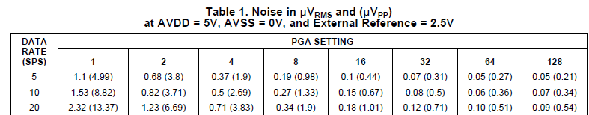
Achievable Resolution with ADS1248
LSB size:
Input referrerd Noise: 3.83uV_{pp}
Pt100 Sensitivity: 1mA x 0.385Ω/°C = 0.385mV/°C
Temperature Resolution per Code: 49.2nV / 0.385mV/°C = 0.0001°C
Noise Free Temperature Resolution: 3.83uV_{pp} / 0.385mV/°C = 0.01°C

